Slide 1

INFO 7225 Module 2
Managerial Accounting (1-6)
Professor Shiaoming Shi
College of Engineering
Northeastern University

Slide 2
Learning objectives
After completing part a of this module, you should be able to
Distinguish between financial and managerial accounting;
Identify the major items in the income statement of various types of firms;
Determine and recognize the fixed and variable components of costs;
Identify cost behaviors and apply them to the business environment;
Explain the concept of contribution margin and apply it to breakeven analysis;
Distinguish between job order costing and process costing;
Understand the concepts of activity-based costing;
Compute the cost of a job using job order costing, process costing, and activity-based costing (ABC).

Slide 3
Financial and Managerial Accounting Comparative
Notes:
Ref. book p92
To help accountants prepare and users better understand financial statements, the profession has outlined
what is referred to as elements of the financial statements, which are those categories or accounts that
accountants use to record transactions and prepare financial statements. There are ten elements of the financial statements, and we have already discussed most of them.

Slide 4
Major Cost Behavior Patterns

Slide 5
Costs Incurred for Different Types of Business
__________________ Business
__________________ Business
__________________ Business

Slide 6
Types of Costs
Product costs are all those associated with the acquisition or production of goods and products.
Period Costs typically related to a particular time period instead of attached to the production of an asset; treated as an expense in the period incurred (examples include many sales and administrative expenses).
Fixed Costs (FC). The costs which don’t vary with changing output. Might include the cost of building a factory, insurance and legal bills. Even if your output changes or you don’t produce anything, your fixed costs stay the same. In the above example, fixed costs are always $1,000.
Variable Costs (VC). Costs which depend on the output produced. For example, if you produce more cars, you need use more raw materials such as metal.
Semi-Variable Cost. Labor might be an example of such cost. If you produce more cars, you need to employ more workers; this is a variable cost. However, even if you didn’t produce any cars, you may still need some workers to look after an empty factory.
Marginal Costs. The cost of producing an extra unit. If the total cost of 3 units is $1550, and the total cost of 4 units is $1900. The marginal cost of the 4th unit is $______________________.
________
______
_________________
____________________
______________
_________
Notes:
https://www.economicshelp.org/blog/4890/economics/types-of-costs/
MC = $1900 - $1550 = $350
Chapter 2.2
Product costs are all those associated with the acquisition or production of goods and products. When products are purchased for resale, the cost of goods is recorded as an asset on the company’s balance sheet. It is not until the products are sold that they become an expense on the income statement. By moving product costs to the expense account for the cost of goods sold, they are easily matched to the sales revenue income account.

Slide 7
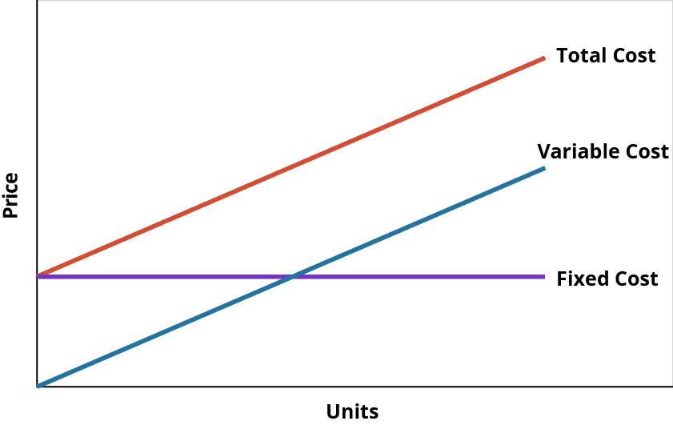
Total Cost as the Sum of Total Fixed Costs and Total Variable Costs

Slide 8
?

Slide 9
Functions of Cost Equations
?
Determine total fixed costs: $50,000 + $75,000 = $125,000
Determine variable costs per unit: $ 50 + $ 20 = $ 70
Complete the cost equation (# of units = x): Y = $125,000 + $70x
Notes:
Ch2.3

Slide 10
Example 1
EA8. LO 2.2 Suppose that a company has fixed costs of $18 per unit and variable costs $9 per unit when 15,000 units are produced. What are the fixed costs per unit when 12,000 units are produced?

Slide 11
Increased activity ___________ per-unit cost;
Decreased activity ___________ per-unit cost.
Notes:
Table2.6

Slide 12
Contribution Margin
and Break-even Analysis
Notes:
Ch3.1

Slide 15
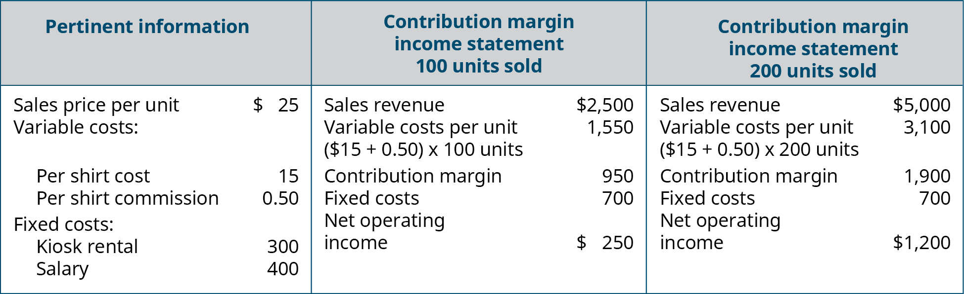
Example 2

Slide 16
(Example 3)
 | Customer A | Customer B
Notes:
(taken from the very end of ch3.1)
Mutually exclusive alternatives

Slide 17
Break-Even Analysis

Slide 18
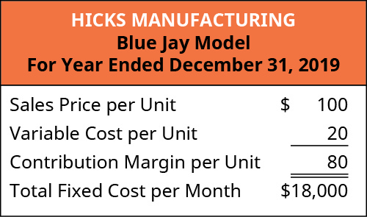
Break-Even Sensitivity Analysis: Introduction
Notes:
$18,000/$80 = 225 units

Slide 19
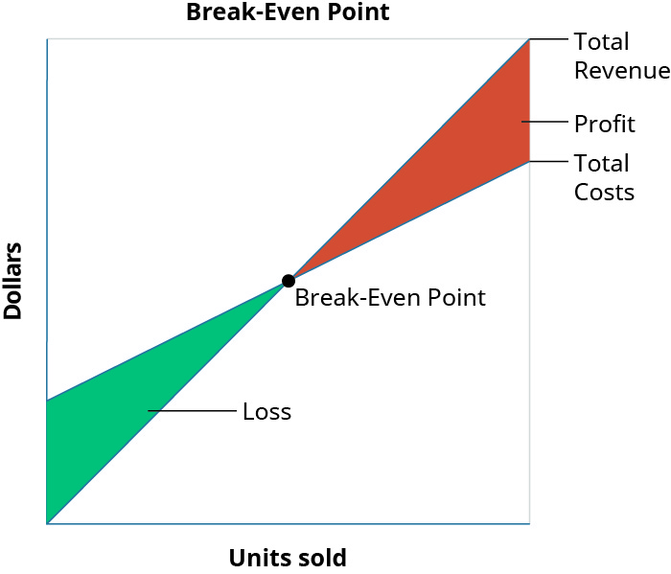

Slide 20
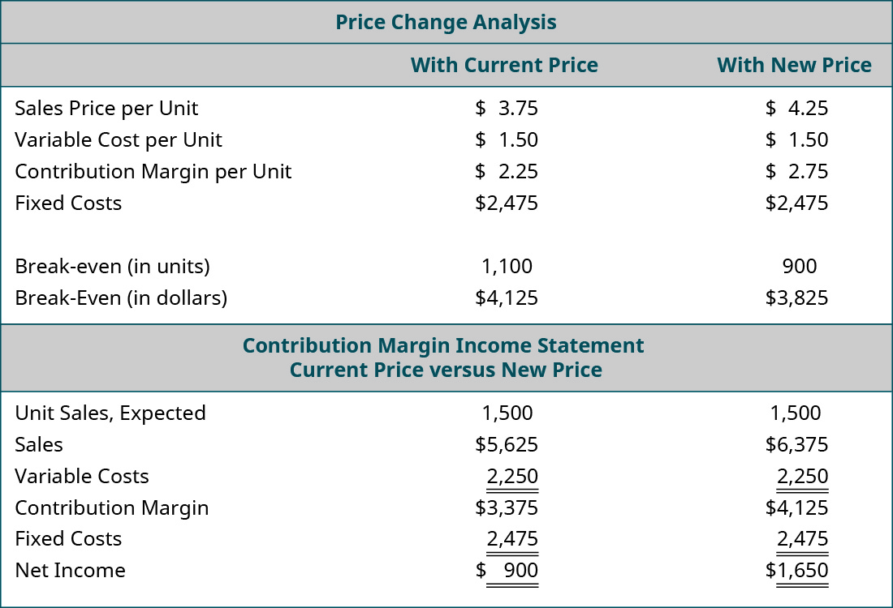
Example 4a: Break-Even Sensitivity Analysis:
Change in Sales Price
The owner of Back Door has one of her employees conduct a survey of the other coffee shops in the area and finds that they are charging $0.75 more for espresso drinks. As a result, the owner wants to determine what would happen to operating income if she increased her price by just $0.50 and sales remained constant, so she performs the following analysis:

Slide 21
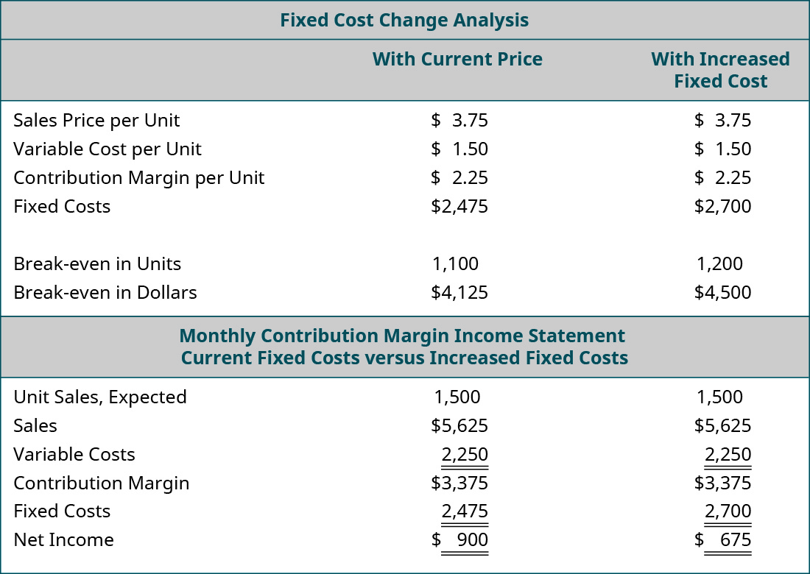
Example 4b: Break-Even Sensitivity Analysis:
Change in Fixed Cost
Back Door Café’s lease is coming up for renewal. The owner calls the landlord to indicate that she wants to renew her lease for another 5 years. The landlord is happy to hear she will continue renting from him but informs her that the rent will increase $225 per month. She is not certain that she can afford an additional $225 per month and tells him she needs to look at her numbers and will call him back. She pulls out her CVP spreadsheet and adjusts her monthly fixed costs upwards by $225. Assume that the example uses the original $3.75 per unit sales price. The results of her analysis of the impact of the rent increase on her annual net income are:

Slide 22
Example

Slide 23
Cost Accounting:
Manufacturing Cost

Slide 24
A General Format for the Income Statement

Slide 25
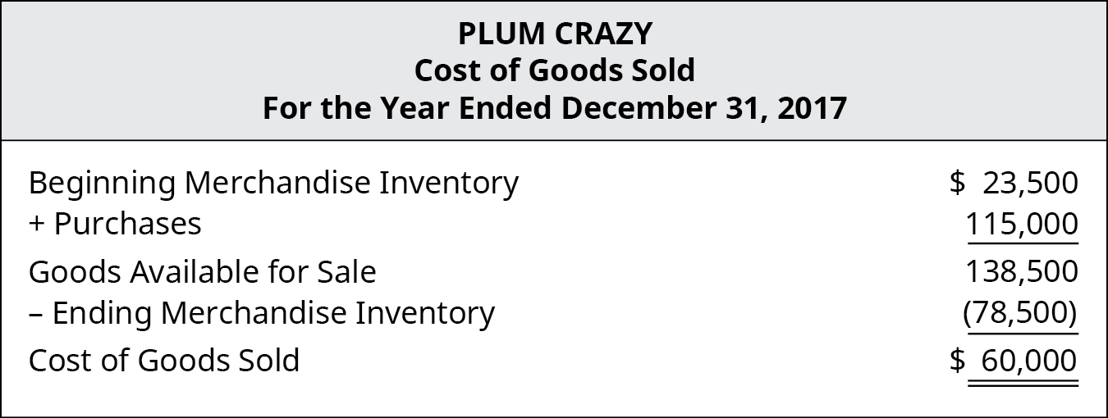
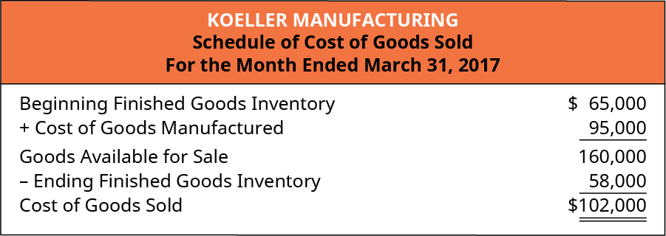
COGS for a Merchandising Firm or a Manufacturing Firm
__________
__________
___________
__________
___________
___________

Slide 26
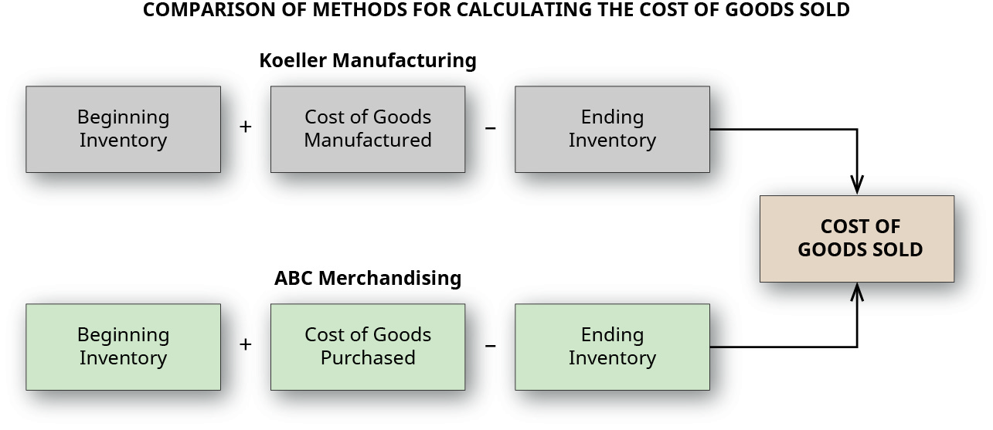
Notes:
22
Figure 2.11 Merchandising firms consider the cost of goods purchased, and manufacturing firms consider the cost of goods manufactured in order to determine the cost of goods sold.
So, even though the income statements for the merchandising firm and the manufacturing firm appear very similar at first glance, there are many more costs to be captured by the manufacturing firm. Figure 2.11 compares and contrasts the methods merchandising and manufacturing firms use to calculate the cost of goods sold in their income statement.

Slide 27
Determining COGS for a Merchandising Firm

Slide 28
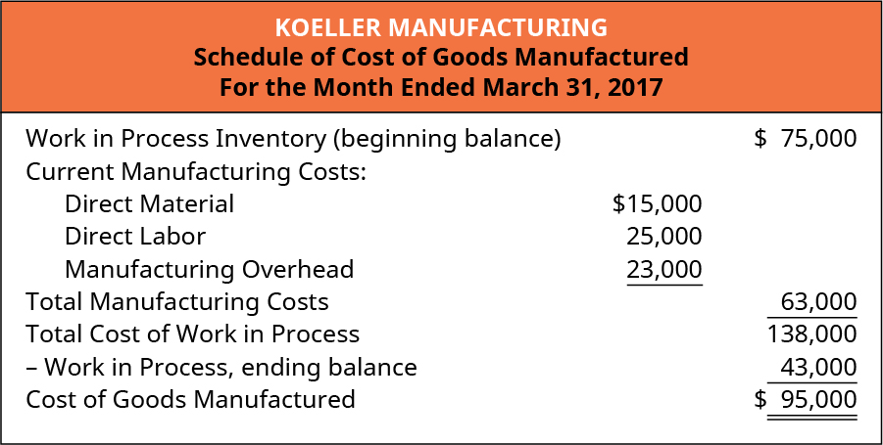
Determining COGS for a Merchandising Firm

Slide 29
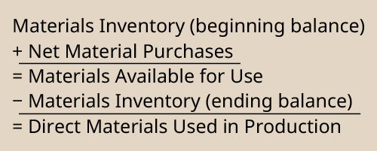
Determining COGS for a Merchandising Firm

Slide 30
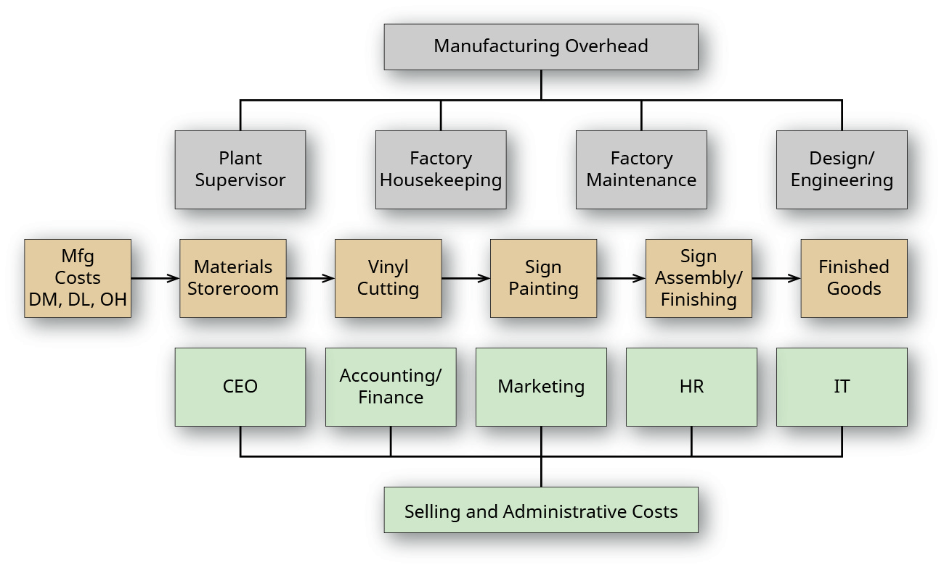
Factory Layout for Dinosaur Vinyl and Manufacturing Costs
Notes:
Figure 4.3 Factory Layout for Dinosaur Vinyl. The flow of goods and areas of manufacturing versus administrative costs are more easily seen by looking at the factory layout for Dinosaur Vinyl. The departments across the bottom represent administrative costs, whereas the departments in the middle represent manufacturing costs—although Design/Engineering can sometimes be considered part of administrative costs, depending on how management chooses to categorize those costs. The departments listed across the top represent examples of manufacturing overhead.

Slide 31
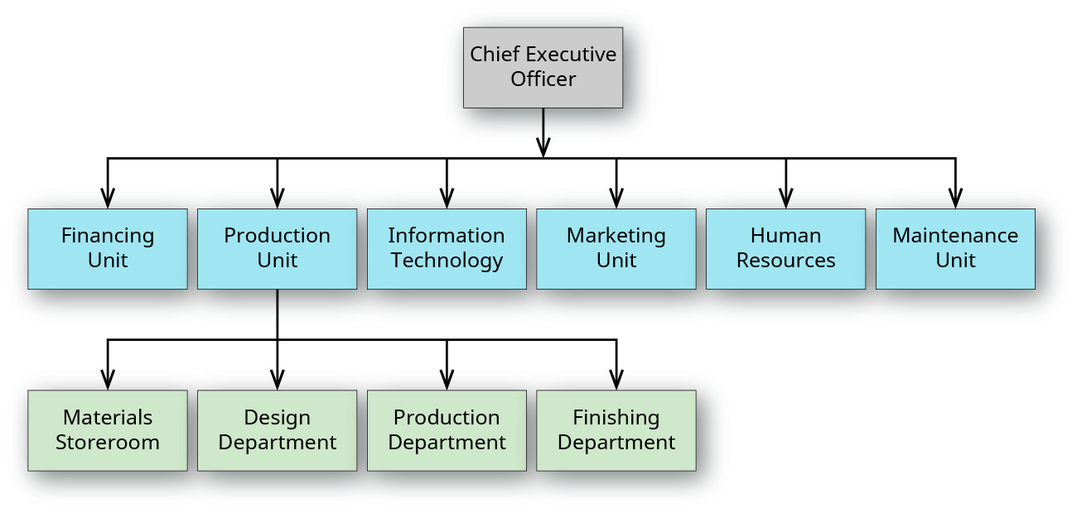
Organizational Chart for a Manufacturing Company

Slide 32
Flow of Materials from Raw Materials to Finished Goods
Notes:
38
Figure 4.4 Manufacturing Costs.
Management sometimes needs additional information to make decisions and needs the costs categorized as prime costs or conversion costs.
Prime costs and conversion costs are not included together as direct labor is included in both categories.
Prime costs are costs that include the primary (or direct) product costs: direct materials and direct labor.
Conversion costs are costs that include the expenses necessary to convert direct materials into a finished product: direct labor and manufacturing overhead. Their relationship is shown in Figure 4.4.

Slide 33
Manufacturing Costs
________ Costs
Manufacturing Overhead
Direct Materials
Direct Labor
___________ Costs
Notes:
38
Figure 4.4 Manufacturing Costs.
Management sometimes needs additional information to make decisions and needs the costs categorized as prime costs or conversion costs.
Prime costs and conversion costs are not included together as direct labor is included in both categories.
Prime costs are costs that include the primary (or direct) product costs: direct materials and direct labor.
Conversion costs are costs that include the expenses necessary to convert direct materials into a finished product: direct labor and manufacturing overhead. Their relationship is shown in Figure 4.4.

Slide 34
Manufacturing Overhead
Costs that support production but are not direct materials or direct labor are considered overhead.
Manufacturing overhead has three components:
Indirect materials
Materials used in production but not traced to specific products because the net informational value from the time and effort to trace the cost to each individual product produced is impossible or inefficient.
Indirect labor
Labor costs of those employees associated with the manufacturing process, but whose contributions are not directly traceable to the final product, and
Overhead
Costs that are necessary for production but not efficient to assign to individual product production. Examples of typical overhead costs are insurance, production facility electricity, warehouse rent, and depreciation of equipment.
Notes:
Indirect material costs are derived from the goods not directly traced to the finished product, like the sign adhesive in the Dinosaur Vinyl example. Tracking the exact amount of adhesive used would be difficult, time consuming, and expensive, so it makes more sense to classify this cost as an indirect material.

Slide 35
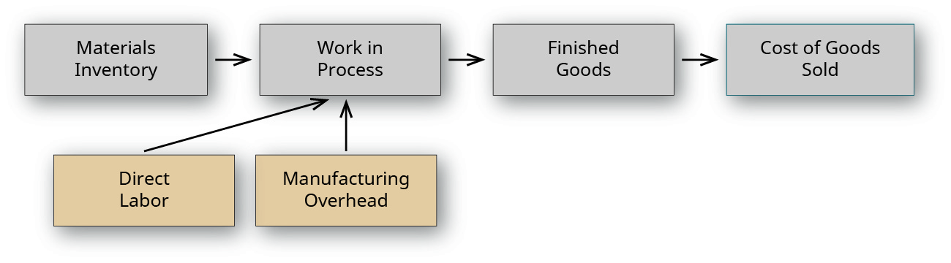
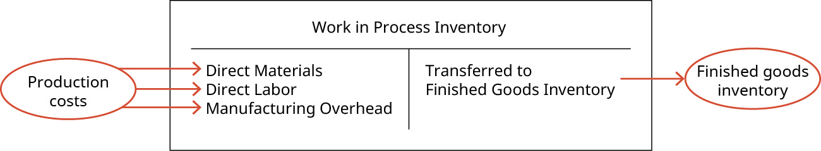
Flow of Materials from Raw Materials to Finished Goods
Notes:
37
Figure 4.6 Flow of Materials from Raw Materials to Finished Goods. Accounting methods track a product’s material, labor, and overhead costs, as it moves through production.
Figure 4.5 Work in Process Inventory. Direct materials, direct labor, and manufacturing overhead enter the work in process inventory as the costs associated with the products that are in production. Once the products are completed, their costs are transferred to the finished goods inventory.

Slide 36
Job Order Costing vs. Process Costing
Notes:
43

Slide 37
Notes:
34

Slide 38
Notes:
Table 5.1

Slide 39
Notes:
https://www.principlesofaccounting.com/chapter-20/cost-allocation/
(online textbook, bookmarked in Safari)

Slide 40
Notes:
A, aaa
B, bbb
C, ccc
https://www.principlesofaccounting.com/chapter-20/cost-allocation/
(online textbook, bookmarked in Safari)

Slide 41
Notes:
https://www.principlesofaccounting.com/chapter-20/cost-allocation/
(online textbook, bookmarked in Safari)

Slide 42
Job Order Costing
Notes:
43

Slide 43
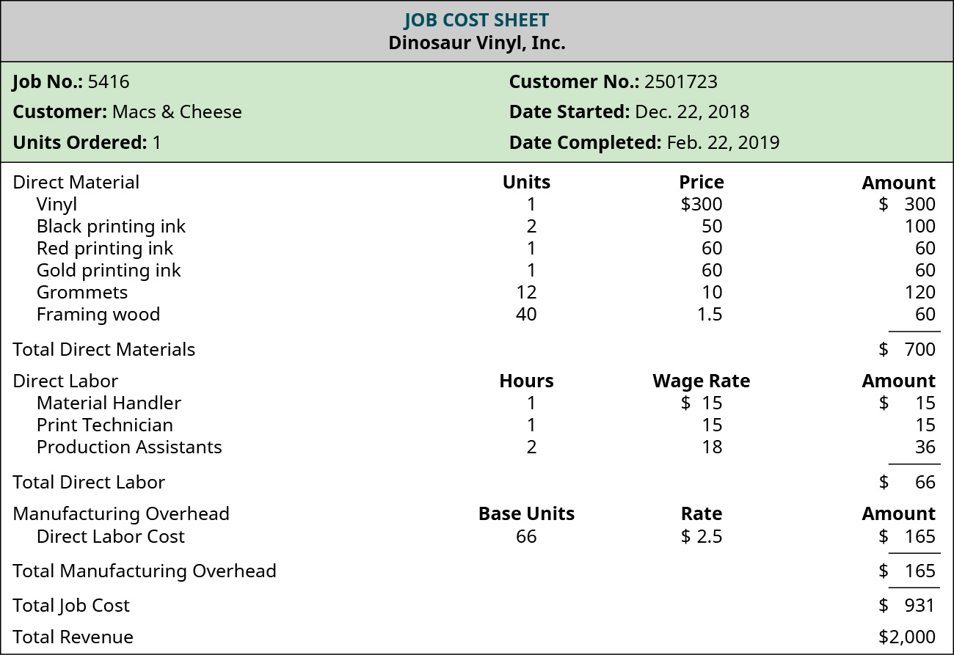

Slide 44
Job Order Costing:
Determining Estimated Overhead Cost

Slide 45
Manufacturing Overhead
Costs that support production but are not direct materials or direct labor are considered overhead.
Manufacturing overhead has three components:
Indirect materials
Materials used in production but not traced to specific products because the net informational value from the time and effort to trace the cost to each individual product produced is impossible or inefficient.
Indirect labor
Labor costs of those employees associated with the manufacturing process, but whose contributions are not directly traceable to the final product, and
Overhead
Costs that are necessary for production but not efficient to assign to individual product production. Examples of typical overhead costs are insurance, production facility electricity, warehouse rent, and depreciation of equipment.
Notes:
Indirect material costs are derived from the goods not directly traced to the finished product, like the sign adhesive in the Dinosaur Vinyl example. Tracking the exact amount of adhesive used would be difficult, time consuming, and expensive, so it makes more sense to classify this cost as an indirect material.

Slide 46
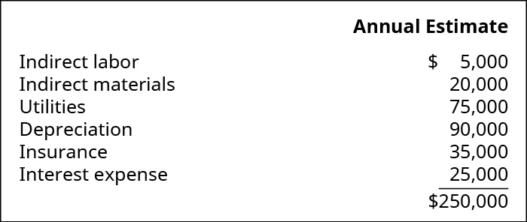
Example 5: Computing a Predetermined Overhead Rate
… uses the expenses from the prior two years to estimate the overhead for the upcoming year to be $250,000:
… also used its payroll records to estimate that it will spend $100,000 on direct labor.
Using the predetermined overhead rate calculation, the overhead rate is:

Slide 47
Example 5: Computing a Predetermined Overhead Rate
… uses the expenses from the prior two years to estimate the overhead for the upcoming year to be $250,000:
Job Order Costing
… also used its payroll records to estimate that it will spend $100,000 on direct labor.
Using the predetermined overhead rate calculation, the overhead rate is:

Slide 48
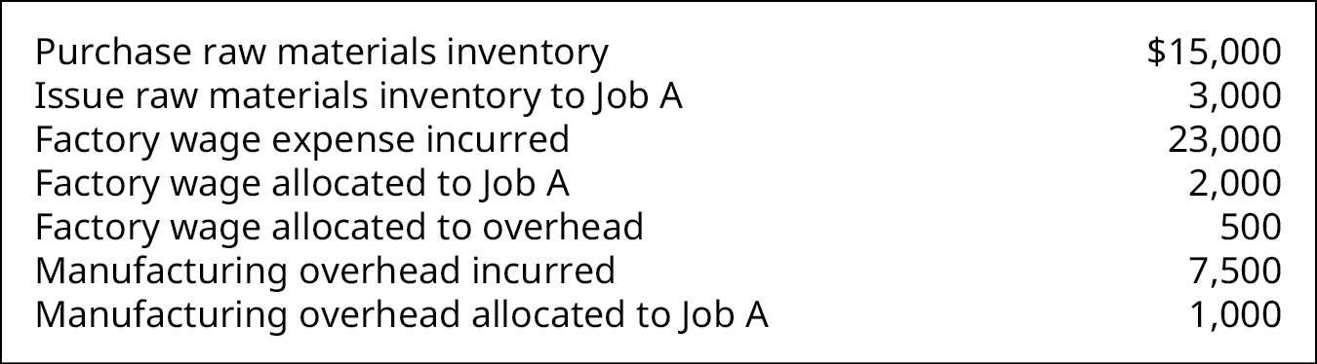
THINK IT THROUGH
(Example 6)
Allocating Costs
A manufacturing company has incurred these costs:
What is the cost allocated to Job A?
Notes:
42

Slide 49
Process Costing
Notes:
43

Slide 50
Process Costing
Process costing is the optimal system for a company to use when the production process results in many similar units.
It is used when production is continuous or occurs in large batches and it is difficult to trace a particular input cost to a specific individual product.
In a “Production Cost Report”, the following information is reported:
Cost per equivalent unit;
Costs to units transferred to finished goods;
costs to partially completed units in the work in process (WIP) inventory.
To prepare a “Production Cost Report”, follow the following four steps:
Determine total units to assign costs;
Compute equivalent units of production;
Determine cost per equivalent unit;
Allocate the costs to units transferred to finished goods and partially completed units in the work in process (WIP) inventory

Slide 51
Equivalent Units (Weighted Average)
Essentially, the concept of equivalent units involves expressing a given number of partially completed units as a smaller number of fully completed units.
We do this because it is easier to account for whole units than parts of a unit. We are adding together partially completed units to make a whole unit.
For example, if we have __ units ____ of the way complete, we can add them together to make __ equivalent unit (= ______________).
We can make this calculation easier by multiplying the units by a percentage of complete.
Notes:
For example, if we have 3 units 1/3 of the way complete, we can add them together to make 1 equivalent unit (1/3 + 1/3 + 1/3).
Units completed and transferred are finished units and will always be 100% complete for equivalent unit calculations for direct materials, direct labor and overhead
For units in ending work in process (WIP), we would take the units unfinished x a percent complete. The percent complete can be different for direct materials, direct labor or overhead.
https://courses.lumenlearning.com/tcc-managacct/chapter/equivalent-whole-units/

Slide 52
Equivalent Units (Weighted Average)
Under the weighted average method, equivalent units are calculated based on 2 things:
Units completed and transferred out, and
Units in ending work in process inventory.
Units completed and transferred are ______________ and will always be ___% complete for equivalent unit calculations for direct materials, direct labor and overhead.
For units in ending work in process (WIP), we would take the units unfinished x a percent complete. The percent complete can be different for direct materials, direct labor or overhead.
Notes:
For example, if we have 3 units 1/3 of the way complete, we can add them together to make 1 equivalent unit (1/3 + 1/3 + 1/3).
Units completed and transferred are finished units and will always be 100% complete for equivalent unit calculations for direct materials, direct labor and overhead
For units in ending work in process (WIP), we would take the units unfinished x a percent complete. The percent complete can be different for direct materials, direct labor or overhead.
https://courses.lumenlearning.com/tcc-managacct/chapter/equivalent-whole-units/

Slide 53
Flow of Materials from Raw Materials to Finished Goods
Notes:
38
Figure 4.4 Manufacturing Costs.
Management sometimes needs additional information to make decisions and needs the costs categorized as prime costs or conversion costs.
Prime costs and conversion costs are not included together as direct labor is included in both categories.
Prime costs are costs that include the primary (or direct) product costs: direct materials and direct labor.
Conversion costs are costs that include the expenses necessary to convert direct materials into a finished product: direct labor and manufacturing overhead. Their relationship is shown in Figure 4.4.

Slide 54
Flow of Materials from Raw Materials to Finished Goods
Notes:
38
Figure 4.4 Manufacturing Costs.
Management sometimes needs additional information to make decisions and needs the costs categorized as prime costs or conversion costs.
Prime costs and conversion costs are not included together as direct labor is included in both categories.
Prime costs are costs that include the primary (or direct) product costs: direct materials and direct labor.
Conversion costs are costs that include the expenses necessary to convert direct materials into a finished product: direct labor and manufacturing overhead. Their relationship is shown in Figure 4.4.

Slide 55
Process Costing
Production Cost Report: | Total | DM ($, % complete, or EU) | CC ($, % complete, or EU)
1. Total costs incurred:
Beginning WIP inventory (units and $)
Started into production this year (units and $)
2. Total equivalent units produced from those costs:
Completed and transferred out (% complete)
Completed and transferred out (# of EU)
Ending WIP inventory (% complete)
Ending WIP inventory (# of EU)
Total equivalent units
3. Costs per equivalent unit
4a. Value of units completed and transferred out
4b. Value of ending WIP inventory

Slide 56
EXAMPLE 7. During the month, Rock City Percussion’s shaping department requested $10,179 in direct material and started into production 8,700 hickory drumsticks of size 5A. There was no beginning inventory in the shaping department, and 7,500 drumsticks were completed in that department and transferred to the finishing department. Wood is the only direct material in the shaping department, and it is added at the beginning of the process, so the work in process (WIP) is considered to be 100% complete with respect to direct materials. At the end of the month, the drumsticks still in the shaping department were estimated to be 35% complete with respect to conversion costs. All materials are added at the beginning of the shaping process.
While beginning the size 5A drumsticks, the shaping department incurred these costs in July:
Direct materials $10,179; direct labor $15,176; applied overhead $7,000; total costs $32,355 (= DM + DL + MOH).
Prepare a production Cost Report for the shaping department using weighted-average method.

Slide 57
Process Costing
Production Cost Report: | Total | DM ($, % complete, or EU) | CC ($, % complete, or EU)
1. Total costs incurred:
Beginning WIP inventory (units and $)
Started into production this year (units and $)
2. Total equivalent units produced from those costs:
Completed and transferred out (% complete)
Completed and transferred out (# of EU)
Ending WIP inventory (% complete)
Ending WIP inventory (# of EU)
Total equivalent units
3. Costs per equivalent unit
4a. Value of units completed and transferred out
4b. Value of ending WIP inventory

Slide 58
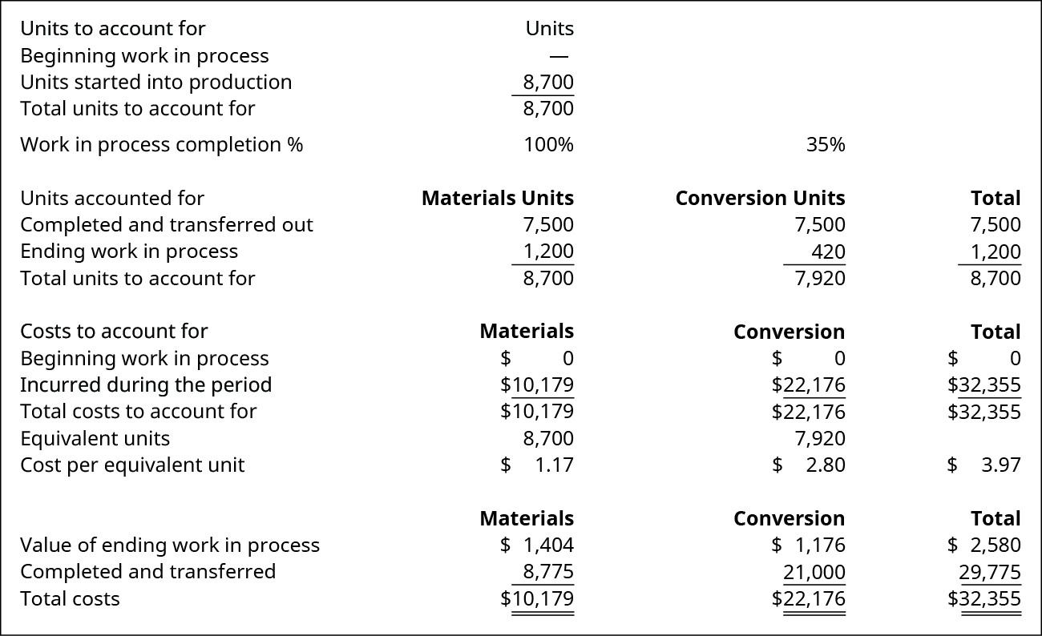
Production Cost Report for the Shaping Department
Notes:
Figure 5.6 Production Cost Report for the Shaping Department.
This information is accumulated in a production cost report. This report shows the costs used in the preparation of a product, including the cost per unit for materials and conversion costs, and the amount of work in process and finished goods inventory. A complete production cost report for the shaping department is illustrated in Figure 5.6.

Slide 59
Production Cost Report for the Shaping Department
Notes:
Figure 5.6 Production Cost Report for the Shaping Department.
This information is accumulated in a production cost report. This report shows the costs used in the preparation of a product, including the cost per unit for materials and conversion costs, and the amount of work in process and finished goods inventory. A complete production cost report for the shaping department is illustrated in Figure 5.6.

Slide 60
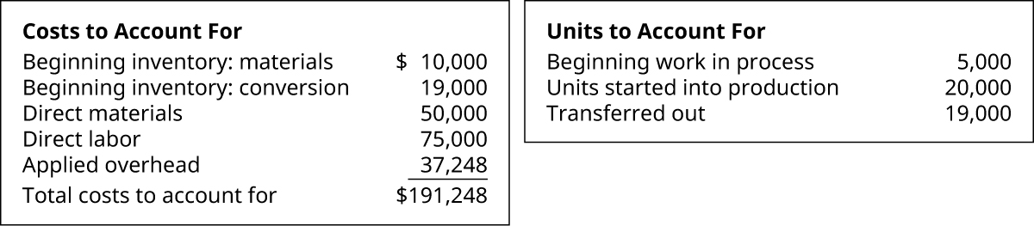
EXAMPLE 8 (Chapter 5, Problem Set A, Problem 5)
Materials are added at the beginning of a production process, and ending work in process inventory is 30% complete with respect to conversion costs. Use the information provided to complete a production cost report using the weighted-average method.

Slide 61
Process Costing
Production Cost Report: | Total | DM ($, % complete, or EU) | CC ($, % complete, or EU)
1. Total costs incurred:
Beginning WIP inventory (units and $)
Started into production this year (units and $)
2. Total equivalent units produced from those costs:
Completed and transferred out (% complete)
Completed and transferred out (# of EU)
Ending WIP inventory (% complete)
Ending WIP inventory (# of EU)
Total equivalent units
3. Costs per equivalent unit
4a. Value of units completed and transferred out
4b. Value of ending WIP inventory

Slide 62
EXAMPLE 9 (Chapter 5, Problem Set A, Problem 3)
Pant Risers manufactures bands for self-dressing assistive devices for mobility-impaired individuals. Manufacturing is a one-step process where the bands are cut and sewn. This is the information related to this year’s production:
Ending inventory was 100% complete as to materials and 70% complete as to conversion, and the total materials cost is $57,540 and the total conversion cost is $36,036. Using the weighted-average method, what are the unit costs if the company transferred out 17,000 units? What is the value of the inventory transferred out and the value of the ending WIP inventory?

Slide 63
Process Costing
Production Cost Report: | Total | DM ($, % complete, or EU) | CC ($, % complete, or EU)
1. Total costs incurred:
Beginning WIP inventory (units and $)
Started into production this year (units and $)
2. Total equivalent units produced from those costs:
Completed and transferred out (% complete)
Completed and transferred out (# of EU)
Ending WIP inventory (% complete)
Ending WIP inventory (# of EU)
Total equivalent units
3. Costs per equivalent unit
4a. Value of units completed and transferred out
4b. Value of ending WIP inventory

Slide 64
Activity-Based Costing (ABC)
Notes:
43

Slide 65
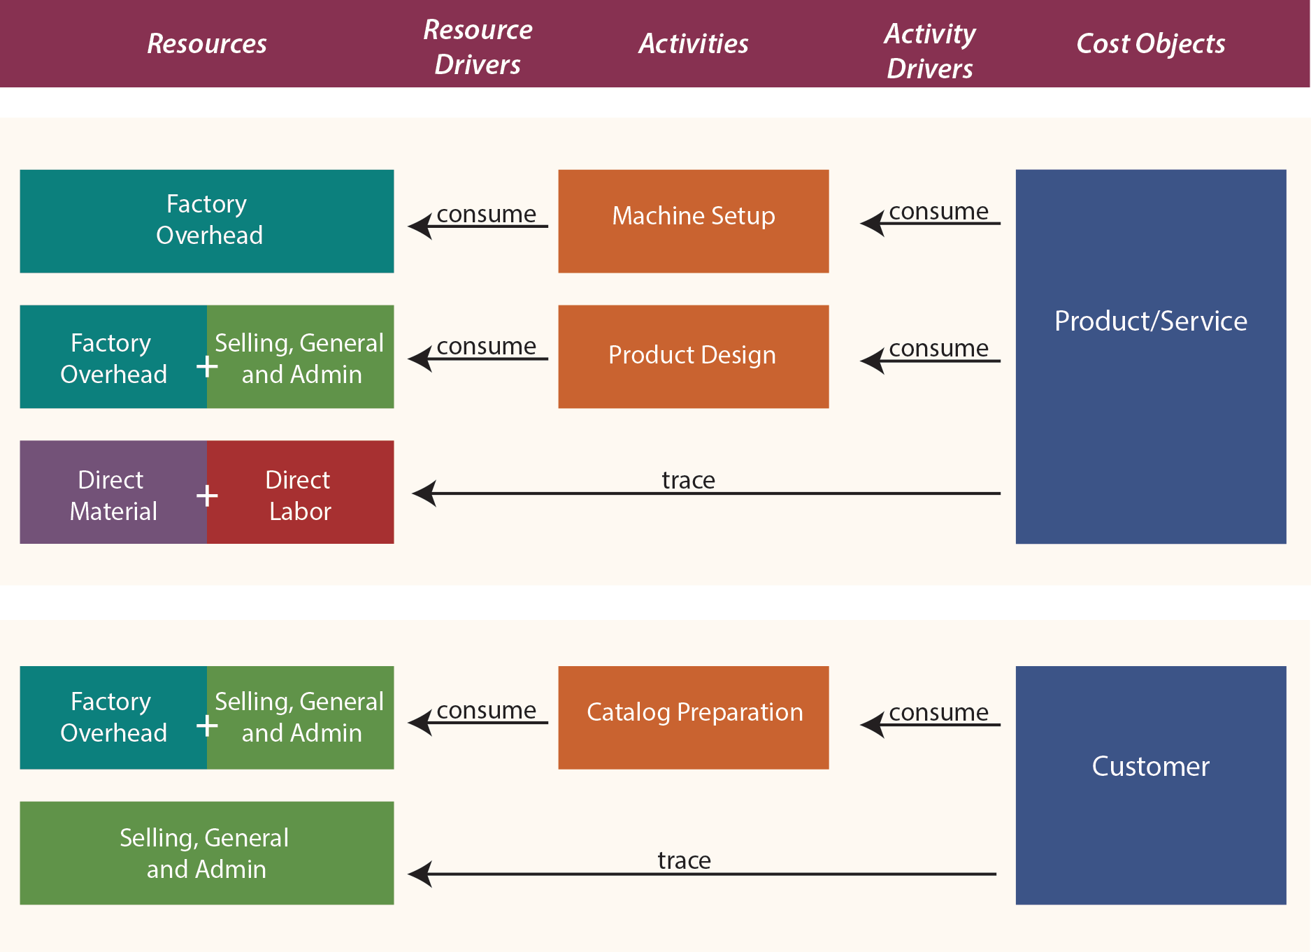
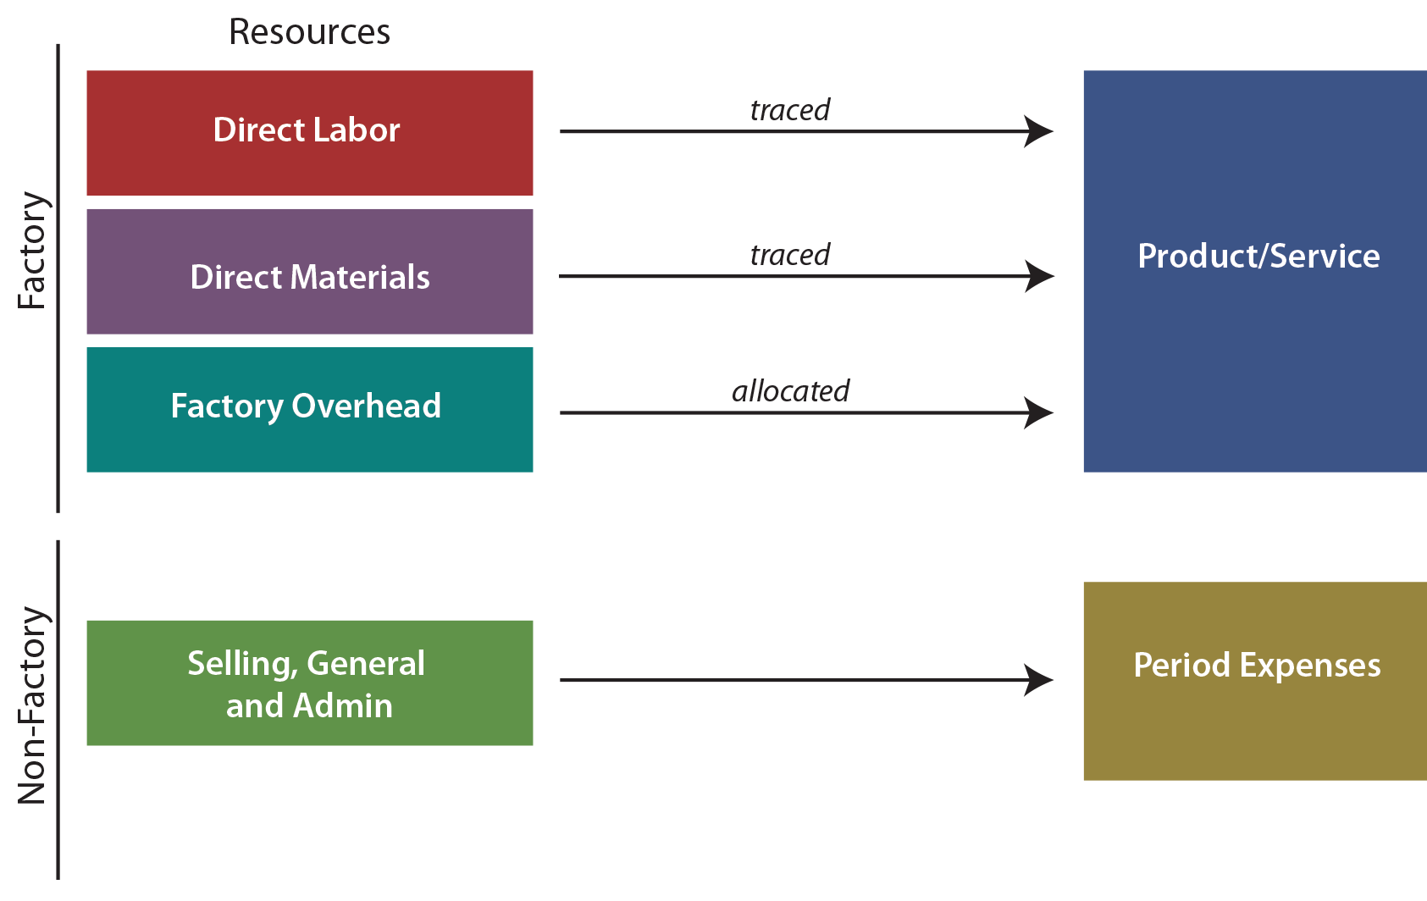
Traditional Costing Methods vs. ABC Concepts
Traditional Costing Methods
ABC Concepts
Notes:
With traditional costing methods, prime costs are traced to output while factory overhead is allocated to output. Non-factory costs do not get assigned to a product.
Compare this traditional logic to ABC, and one sees a reversal of the thought process.
With ABC, cost objects are broadened to include not only products/services, but also other objects like customers, markets, and so on.
These “cost objects” are seen as consuming activities.
The activity driver is the event that causes consumption of an activity. For instance, each customer may receive a catalog, whether he or she orders or not during a period.
Preparation and distribution of the catalog is the “activity” that is being driven by the number of customers. Activities necessarily consume resources. Thus, preparation of a catalog will require labor, printing, office space, etc. Thus, activities drive the need for resources and are said to be resource drivers.
The following graphic (illustration on the right) reveals the conceptual notion of ABC for two types of cost objects, which is quite different and much more involved than the traditional costing approaches. In reviewing the graphic, notice that costs that are directly traced to a cost object need not be “routed” through an activity:

Slide 66
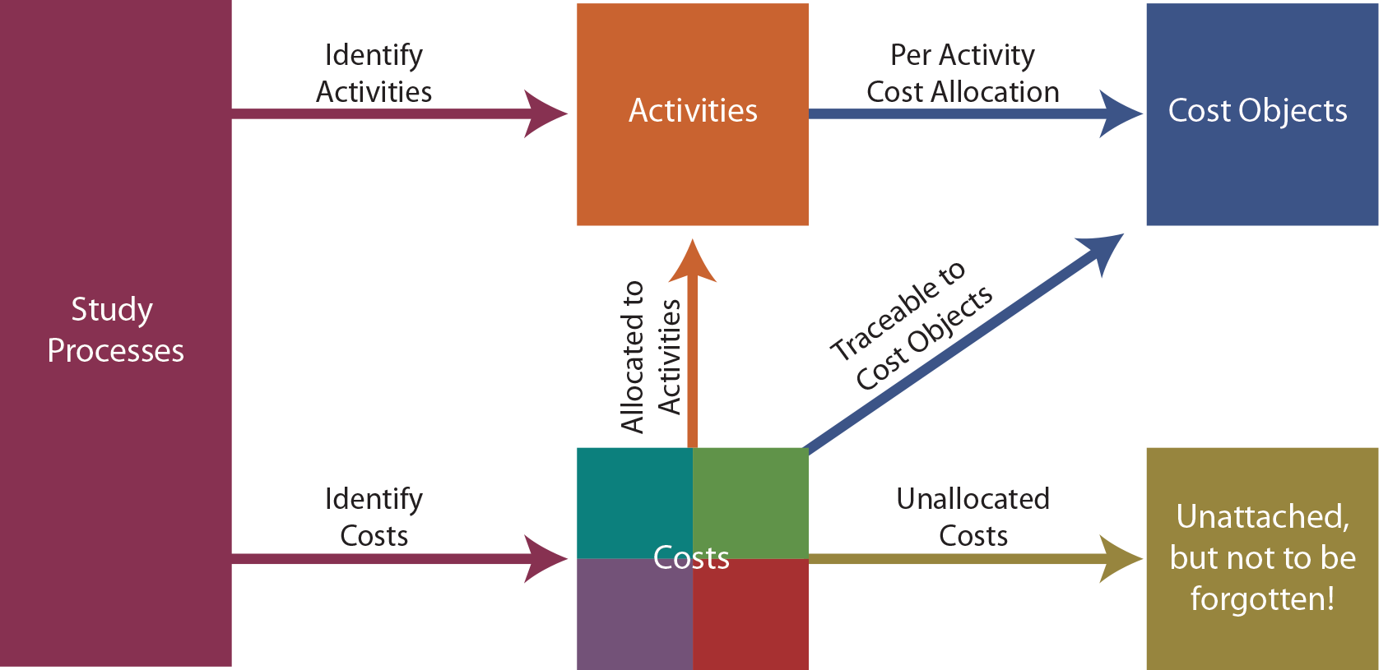
Steps to Develop an ABC System
Notes:
https://www.principlesofaccounting.com/chapter-20/activity-based-costing/
The necessary steps to develop an ABC system are summarized as follows:
The first step is a detailed study of all business processes and costs. This extensive study will usually involve employees from throughout the organization.
Once a business is understood, care should be used in selecting the business activities that will be central to the cost allocations. Too many activities and the system will become unmanageable; too few and the information will not be meaningful.
IDENTIFY TRACEABLE COSTS — Some costs can be traced directly to an end object. One example is the direct material and direct labor that goes into a product. But, there are other examples. The preparation of a product catalog can consume many hours of indirect labor and other internal resources that would be attributable to a related activity cost pool; but, it may also involve an outside printer/postage and that cost can be traced directly to the “customer” cost object.
ASSIGN REMAINING COSTS TO ACTIVITIES — Remaining costs are assigned to activities. As an example, there may be a separate industrial engineering group that does nothing but machine setup prior to a production run. The cost of this group is easily assigned to the machine setup activity, which in turn will be reallocated to a variety of end products. However, the janitorial group may perform a major cleanup after each machine setup. Perhaps 10% of the janitorial staff’s time should be assigned to machine setup and the other 90% to general maintenance.
Some resources are consumed, and no one can agree as to the cost object that should absorb the resource. For example, what object should bear the cost of landscaping the corporate office? Suffice it to say that the cost allocation decisions can be contentious, and some costs may never find a logical home. Therefore, ABC may leave some costs as unallocated. Unallocated does not mean to “ignore.” While it may be perfectly logical to leave some costs as unallocated for purposes of identifying the cost of a specific product or other cost object, it would be foolhardy to forget about those costs in overall management of the organization.
DETERMINE PER-ACTIVITY ALLOCATION RATES — Once costs for each activity have been determined, it is then necessary to unitize the cost pool. For example, if the catalog preparation activity cost pool contained $500,000 and 200,000 catalogs were produced, then the allocated catalog cost would be $2.50 each.
APPLY COSTS TO OBJECTS — The final step is to utilize the activity-based rates in determining the amount of activity cost to allocate to each cost object. The allocated cost from the catalog preparation pool was $2.50 per unit. This is not the total cost; this is just the allocated amount. The total cost would also include the directly traceable amounts (printing, postage, etc.). This catalog cost, along with other customer-related costs, would be compiled in a summary report. Managers would then have a measure of how much it costs to support one additional customer. Similarly, measures would be produced for each additional cost object.

Slide 67
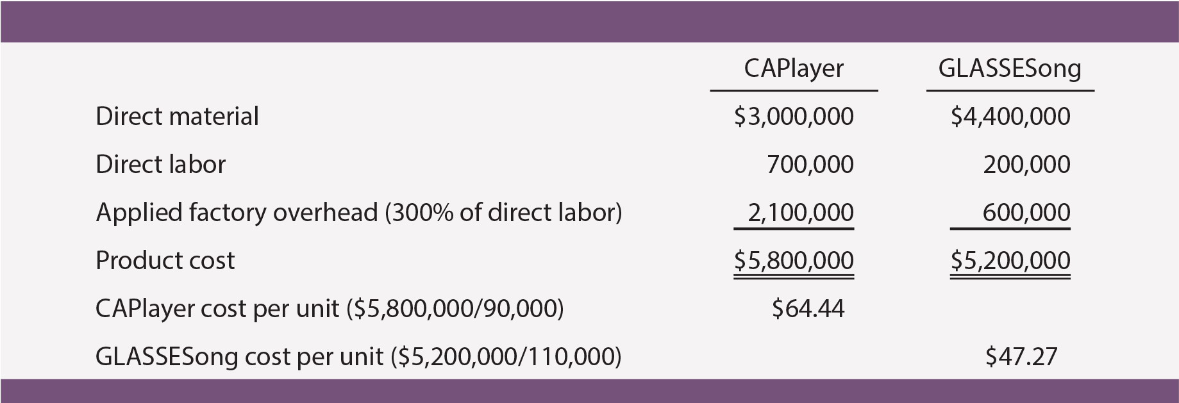
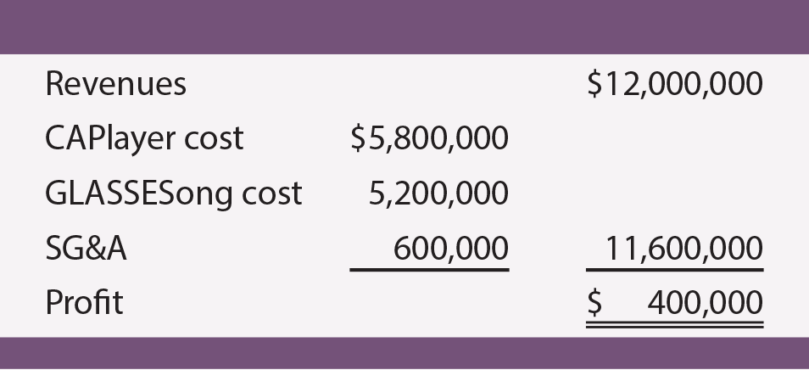
Example 10
Golf and Music Enthusiast Company (GAME) developed two specialized products. The first product is GLASSESong, a pair of sunglasses with a built-in music player. The other is CAPlayer, a golf cap with a built-in music player having a very short unobtrusive cord from the cap to the speakers.
GAME has been employing traditional costing methods and applies factory overhead on the basis of labor costs. The products sell as fast as they can be produced so there is virtually no inventory. For a recent period CAPlayer sold 90,000 units and GLASSESong sold 110,000 units and each unit sells for $60.
Notes:
Revenue = $60/u x (90,000+110,000) u = 60*200,000 = $12 x 10^6
MOH = $2,700
OH: $3/$ of DL
Cost per unit = $5800/90 = $64.44
$5200/110 = $42.27

Slide 68
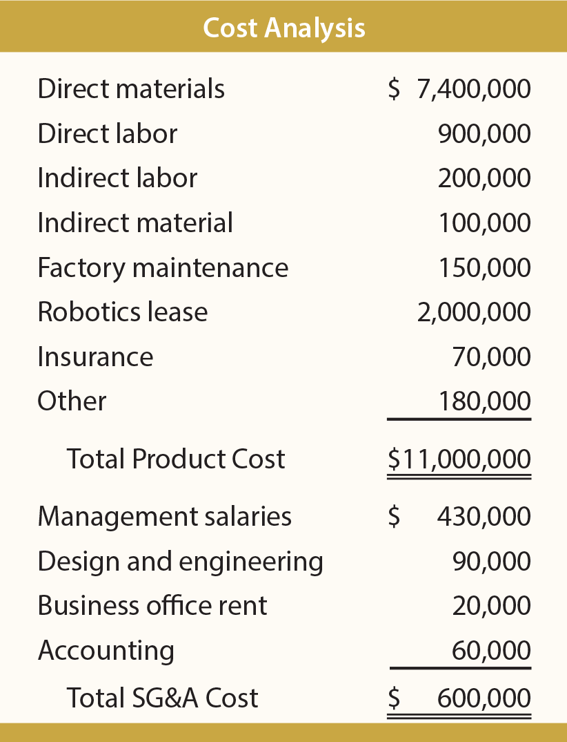
Activity-Based Costing (ABC):
Study Processes and Costs | Identify Activities
The consultant’s study began with a review of the business, which revealed the following:
Product costs were $11,000,000 and SG&A $600,000 as shown in the analysis.
The core components are the same for each device.
GLASSESong requires added material related to polarized lenses and CAPlayer requires added direct labor for sewing.
Both devices are produced in batches on the same automated assembly line, at the same pace, and through similar steps.
Automated machinery is leased from Rebel Robotics, which bases its rental charges on a “units processed” basis.
There is one production line, and it must be “set up” for each production batch.
CAPlayers are produced in batches of 900 and GLASSESongs are produced in batches of 550 units. As a result CAPlayer required 100 setups (90,000 units/900 units per setup) and GLASSESong required 200 setups (110,000 units/550 units per setup).
A tech support department has been established to help customers download music to their devices. The CAPlayers are sold and supported only through the world’s 1,000 most exclusive golf courses. The golf pros at these courses usually call once to learn the product and require no further assistance. The GLASSESong units are sold over the internet, and individual purchasers average one call per unit sold.
Both products were designed by an internal development team.
Notes:
DM = $3,000 + $4,400 = $7,400
DL = $7,000 + $2,000 = $9,000

Slide 69
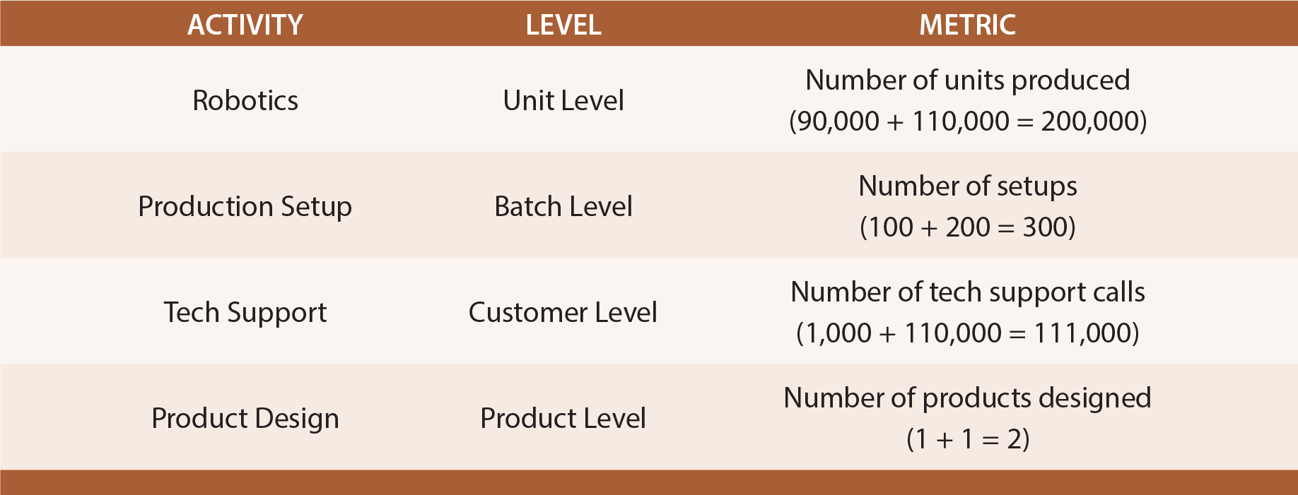
The consultant’s study began with a review of the business, which revealed the following:
Product costs were $11,000,000 and SG&A $600,000 as shown in the analysis.
The core components are the same for each device.
GLASSESong requires added material related to polarized lenses and CAPlayer requires added direct labor for sewing.
Both devices are produced in batches on the same automated assembly line, at the same pace, and through similar steps.
Automated machinery is leased from Rebel Robotics, which bases its rental charges on a “units processed” basis.
There is one production line, and it must be “set up” for each production batch.
CAPlayers are produced in batches of 900 and GLASSESongs are produced in batches of 550 units. As a result CAPlayer required 100 setups (90,000 units/900 units per setup) and GLASSESong required 200 setups (110,000 units/550 units per setup).
A tech support department has been established to help customers download music to their devices. The CAPlayers are sold and supported only through the world’s 1,000 most exclusive golf courses. The golf pros at these courses usually call once to learn the product and require no further assistance. The GLASSESong units are sold over the internet, and individual purchasers average one call per unit sold.
Both products were designed by an internal development team.

Slide 70
Activity-Based Costing (ABC):
Study Processes and Costs | Identify Activities

Slide 71
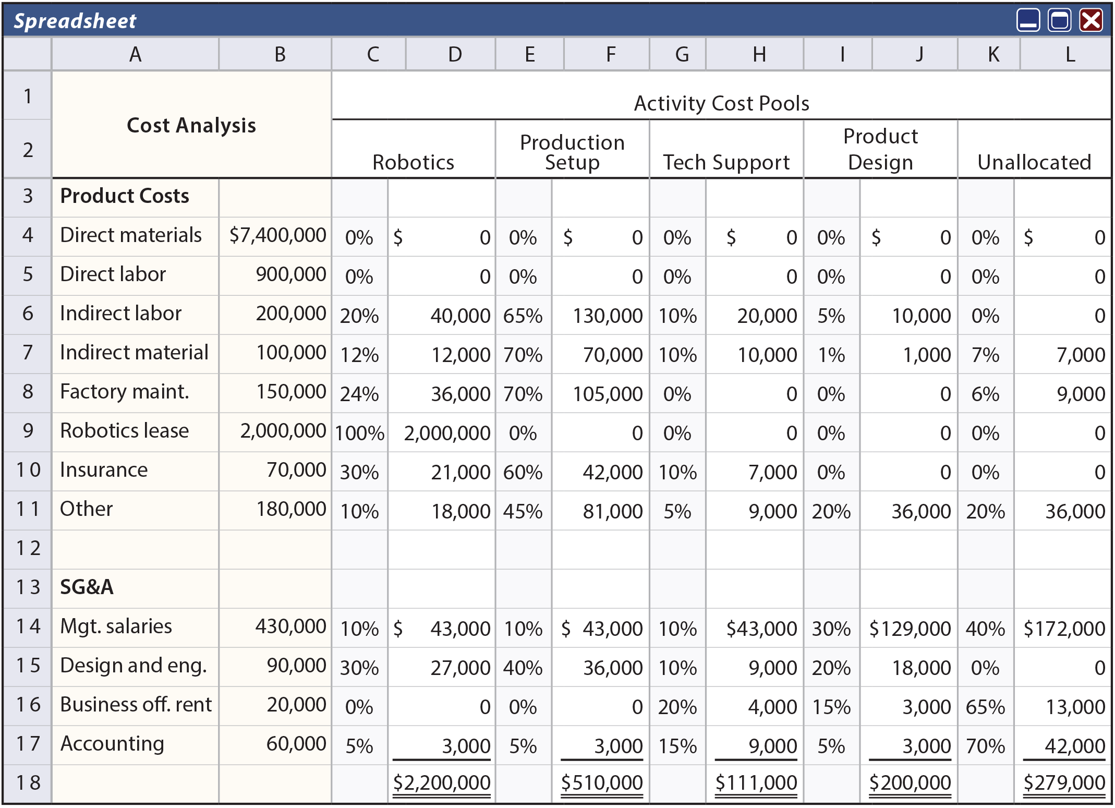
Allocate Costs
Notes:
Cost pools

Slide 72
Allocate Costs
Notes:
Cost pools

Slide 73
Allocate Costs
Notes:
DM = 3000 + 4400 = $7,400,000
DL = 700 + 200 = $900,000
MOH = Indirect labor + … + Other = $2,700
Product costs = DM + DL + MOH = $11,000
Product cost in total = $5,800 + $5,200 = $11,000
SG&A = Mgt. salaries + … + Accounting = $600,000

Slide 74
Allocate Costs
Notes:
DM and DL: traceable directly; not based on the activities
MOH = Indirect labor + … + Other = $2,700
SG&A = Mgt. salaries + … + Accounting = $600,000
MOH + SG&A = $2,700 + $600 = $3,300 (k) will need to be allocated based on activities

Slide 75
Allocate Costs
Notes:
20%+65%+10%+5%+0% = 100%
$200,000 total indirect labor cost is allocated based on the % of each activity cost pool

Slide 76
Allocate Costs

Slide 77
Allocate Costs

Slide 78
Allocate Costs

Slide 79
Allocate Costs

Slide 80
Allocate Costs
Notes:
10%+45%+5%+20%+20% = 100%

Slide 81
Allocate Costs
Notes:
Product costs in total = $11,000,000
CAPlayer cost + GLASSESong cost =$5,800,000 + $5,200,000 = $11,000,000

Slide 82
Allocate Costs

Slide 83
Allocate Costs

Slide 84
Allocate Costs

Slide 85
Allocate Costs

Slide 86
Allocate Costs
Notes:
2200+510+111+200+279 = $3,300,000 = total activity cost pools
MOH = Indirect labor + … + Other = $2,700
SG&A = Mgt. salaries + … + Accounting = $600,000
MOH + SG&A = $2,700 + $600 = $3,300

Slide 87
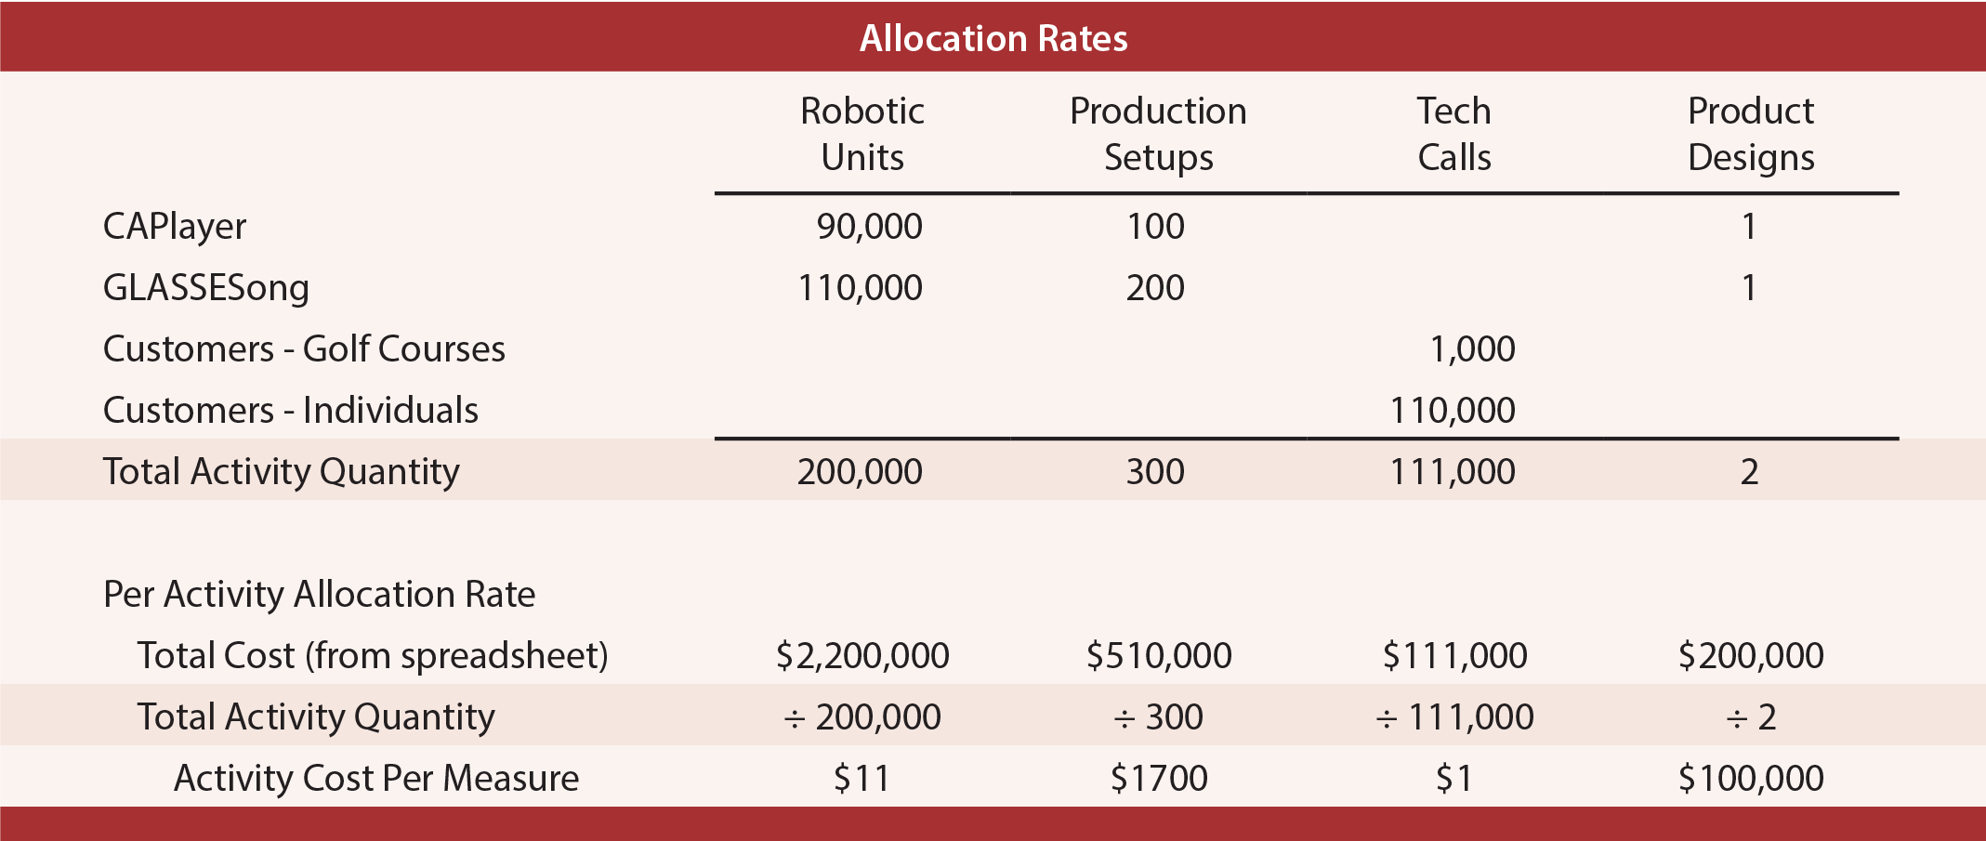
Determine Per-Activity Rates
Notes:
The total cost for each activity pool is divided by the activity quantity metric. For example, robotics cost $2,200,000 and 200,000 units were produced. Thus, this activity cost is $11.00 per unit. This calculation is repeated for each activity cost pool, and is summarized in the following schedule.

Slide 88
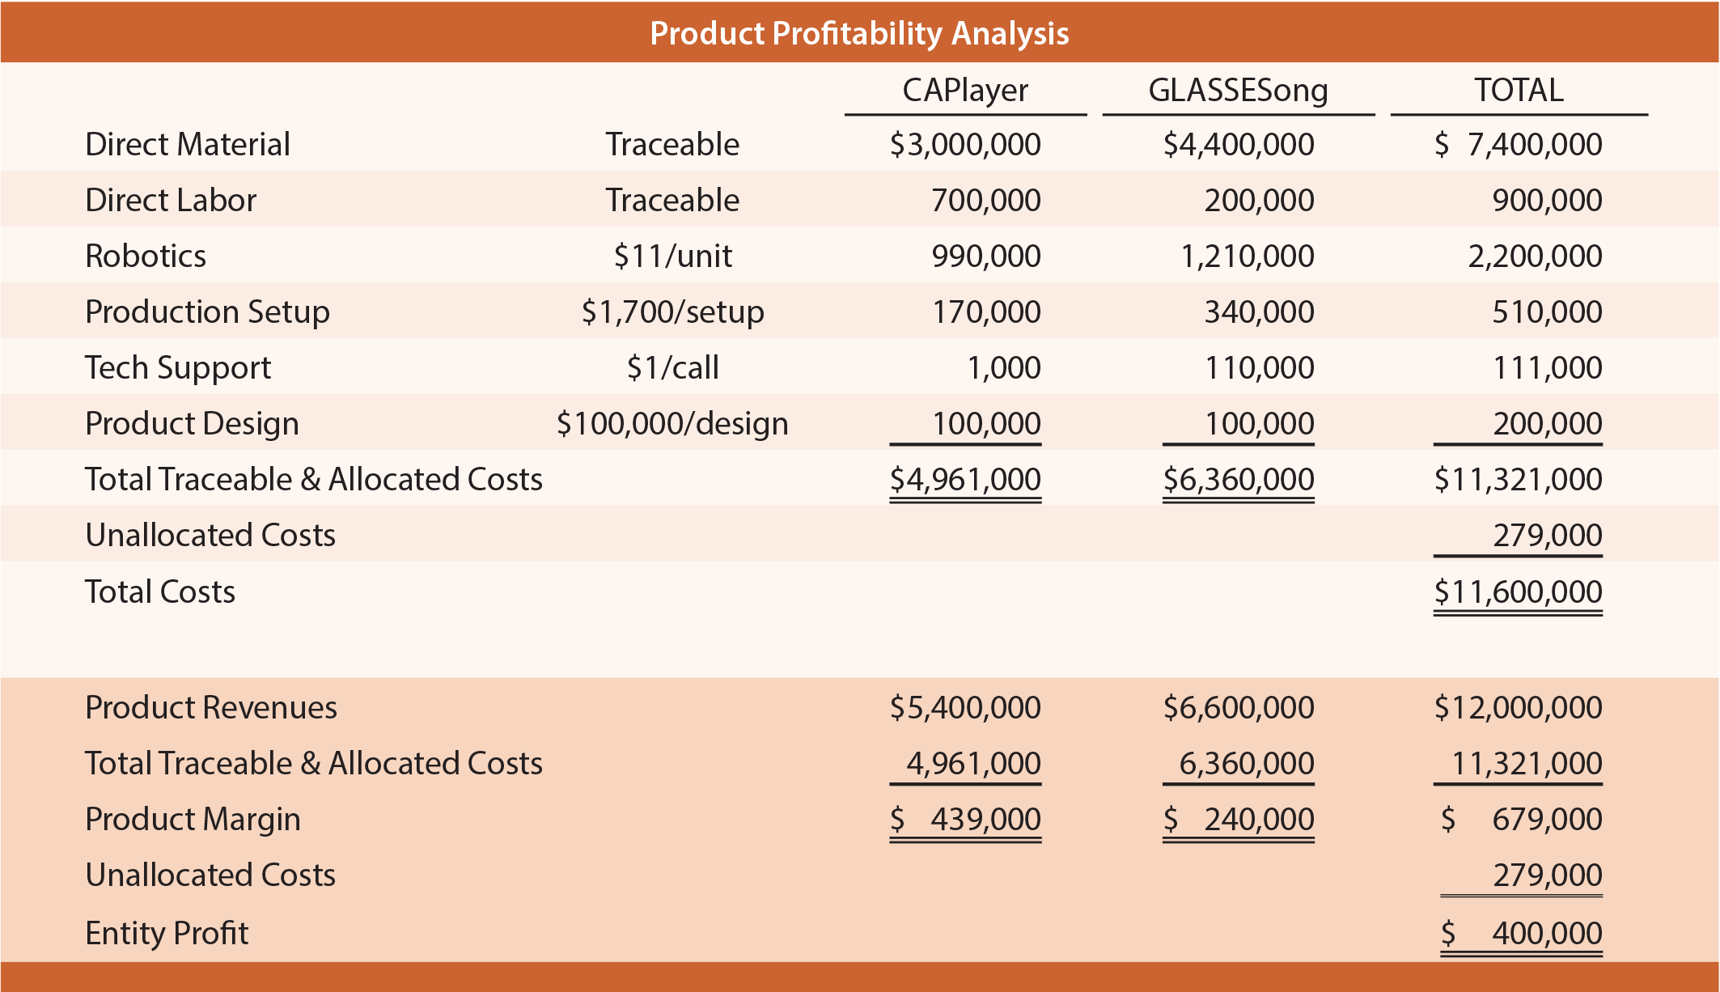
Apply Costs to Cost Objects
Notes:
The final step is to analyze results.
The top portion of the following analysis applies the per-activity cost information to show how the total cost of CAPlayer is less than the total cost of GLASSESong.
2nd column: 4 allocation rates (per-activity rates) determined in the previous slide

Slide 89
Apply Costs to Cost Objects
Notes:
The lower portion compares costs and revenues to determine product profitability. Unallocated cost is included in the total column only; it is important, but not tied to either product.
Product profitability is portrayed differently under alternative costing methods. Traditional costing applied overhead based on direct labor, which is a small portion of the environment. The point is that skill is required to interpret any costing information.

Slide 90
Example 10: Traditional Costing Method
Golf and Music Enthusiast Company (GAME) developed two specialized products. The first product is GLASSESong, a pair of sunglasses with a built-in music player. The other is CAPlayer, a golf cap with a built-in music player having a very short unobtrusive cord from the cap to the speakers.
GAME has been employing traditional costing methods and applies factory overhead on the basis of labor costs. The products sell as fast as they can be produced so there is virtually no inventory. For a recent period CAPlayer sold 90,000 units and GLASSESong sold 110,000 units and each unit sells for $60.
Revenue
Product margin (traditional costing method)
Product margin (ABC method) $439,000 $240,000
Notes:
Traditional costing:
CM CAPlayer = $60x90,000 - $5,800,000 = $5,400,000 - $5,800,000 = -$400,000
CM GLASSESong = $60x110,000 - $5,200,000 = $6,600,000 - $5,200,000 = $1,400,000
Total CM = $1,000,000
Profit = Total CM - SG&A = $1,000,000 - $600,000 = $400,000
Revenue = $60/u x (90,000+110,000) u = 60*200,000 = $12 x 10^6
MOH = $2,700
OH: $3/$ of DL
Cost per unit = $5800/90 = $64.44
$5200/110 = $42.27

Slide 91
Summary
Contribution margin can be used to calculate how much of every dollar is available to cover _________________ and contribute to _______.
Contribution margin can be expresses on a ________ basis, as a ____, or in ____.
Break-even analysis is a tool that almost any business can use for _________ and _________ process. It helps to identify a _____________ that is necessary before an organization starts to generate a profit.
Notes:
To cover fixed expenses and contribute to profit
expresses on a per-unit basis, as a ratio, or in total
use for planning and evaluation process
identify a level of activity that is necessary

Slide 92
Summary
The three components of manufacturing costs are direct material, direct labor, and manufacturing overhead (MOH).
Job order costing is the optimal costing method for producing _______ goods or when it is easy to identify the cost ________ with the product. MOH is assigned to the individual jobs using the predetermined overhead rate.
Process costing is the system of accumulating costs within each ___________ for large-volume, mass-produced units. Process costing determines the cost per unit through the use of _______________.
Notes:
To cover fixed expenses and contribute to profit
expresses on a per-unit basis, as a ratio, or in total
use for planning and evaluation process
identify a level of activity that is necessary

Slide 93
Summary
SG&A is treated as a _______ cost in traditional costing systems.
Traditional methods is optimal when the manufacturing process is labor driven and overhead increases based on traditional activity bases, such as direct labor hours, direct labor dollars, or machine hours.
Notes:
producing custom goods, or directly
within each department; through the use of equivalent units
SG&A is treated as a period cost in traditional costing systems

Slide 94
Summary
Activity-based costing assigns overhead costs based on several __________ and the __________ that drive costs.
Activity-based costing is optimal when the manufacturing process is ___________ __________ and overhead increased based on various activities the differ for each product.
Process costing is the system of accumulating costs within each ___________ for large-volume, mass-produced units. Process costing determines the cost per unit through the use of _______________.
Notes:
based on several cost pools and the activities that drive costs
when the manufacturing process is technology driven

Slide 95
Thank you!

